Slide 1
Intermediate presentation Group 1
Thor Galle
Midas Lambrichts
Ruben Vroonen

Slide 2
Motivation

Slide 3
Problem
For what purpose do people use their bike downtown?
And which routes do they take?
Is it faster/easier than using the car?
Notes:
What is the problem that the visualization will try to explain or solve?
Why is this problem important?
Why is this problem complex?

Slide 4
Data

Slide 5
Dataset
2 possible cities:
Washington
Rental city bikes (Capital bikeshare)
2010-2018
Timing and station marking
Antwerp
European cycling challenge 2015 (Cycling365)
May 2015
Timing and GPS coordinates

Slide 6
Motivation: biking in Antwerp
The city of Antwerp has introduced a low emission zone in februari 2017
People are more encouraged to use green alternatives
For what purpose did citizens use their bike beforehand?
Can the bike make the car obsolete?
Many datasets about city available at http://opendata.antwerpen.be
Notes:
Better data for visualization

Slide 7
Example
"features": [
{ "type": "Feature",
"properties": {
"TripID": "552674bb88c537dc7a33d013",
"POINTCOUNT": 41,
"STARTTIME": "2015-04-09 14:43:21",
"STOPTIME": "2015-04-09 14:46:41",
"REAL_SPEED": 21.050561,
"DIFF_TIME": 3.333333 },
"geometry": {
"type": "LineString",
"coordinates": [
[ 4.398873995936325, 51.205639002415964 ],
[ 4.398835995936315, 51.205471002416 ],
Approximately every 5 seconds

Slide 8
Insights

Slide 9
Insights
What data-driven insight(s) do you expect your visualization to reveal?
Show them with rough data representations (e.g. Excel, Tableau).

Slide 10
Design rationale

Slide 11
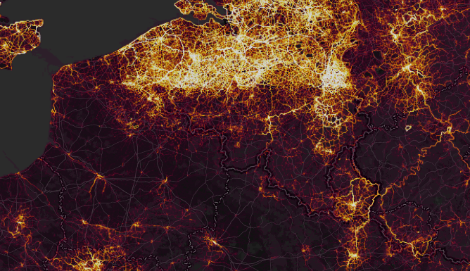
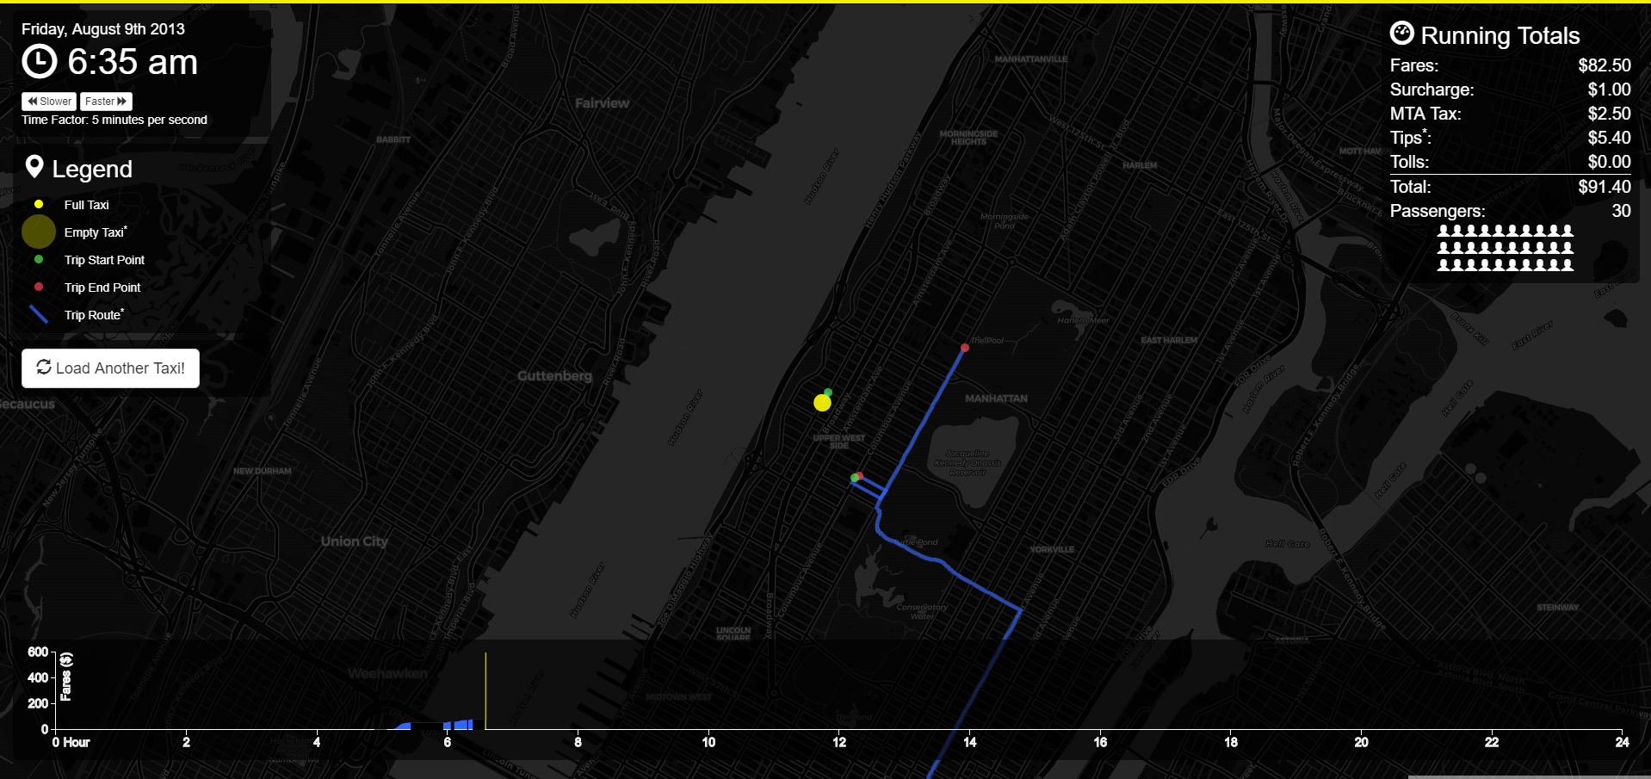
Design inspiration
Strava Global Heatmap
Follow NYC Cab for one day
https://www.strava.com/heatmap
http://chriswhong.github.io/nyctaxi/
Heatmap from routes, not points
Highlighting few from the many
can be very interesting.
Notes:
Midas

Slide 12
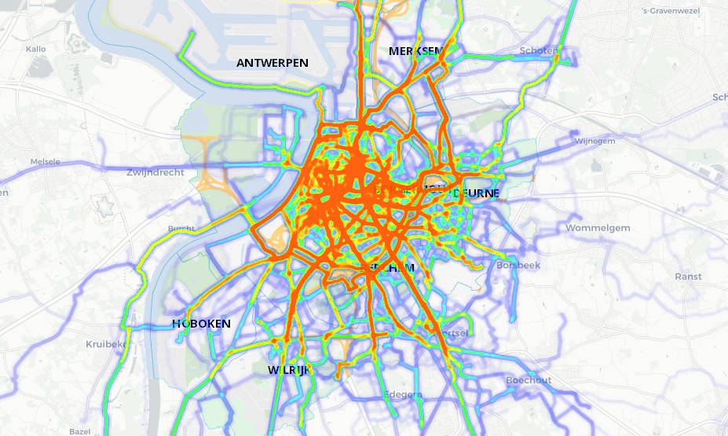
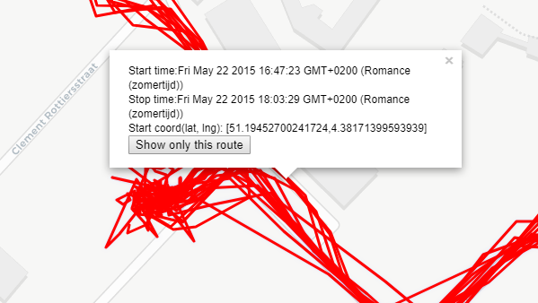
Design rationale
How will the insights be revealed via the visualization?
What design decisions did you make? Based on what reasoning?
Heatmap
Individual Routes
Gain insight into the many
Gain insight into the few
Notes:
Midas

Slide 13
Communication

Slide 14
Communication
Take the user through a “tutorial” which will show some interesting points and the effect of the controls before releasing control.
Show heatmap of bike routes
Plots containing numeric information of heatmaps

Slide 15
Interaction
Standard map controls (zoom & pan)
Determine heatmap parameters so they can gain more insight themselves
Determine visibility of city features like stores, schools, …
Possibility to show plots of data given a set of parameters

Slide 16
Demo

Slide 17
Demo
http://iv.kul/acopy.html
Notes:
Midas
To show:
story() //Hier zien we een uitschieter
Story() // Filteren op wanneer hij sochtends vertrekt
Story() // Filteren wanneer hij aankomt
Story() // Nieuwe map layer om eenrichtingsverkeer te zien.
// Reload
storyFilter3() // Wegen die bij hem thuis vertrekken
storyFilter4() // Wegen die bij hem thuis aankomen
// Reload en ga naar boudewijnstraat (driehoek)
Filter.startOrStopNear([51.205171, 4.398712], 100)

Slide 18
Planning

Slide 19
Planning
Finish Controls
Add more data representations (Graphs, Parallel Coordinates,…)

Slide 20
?

